Slide 1
Cognos Tabs
By Bryan Mack

Slide 2
Cognos Tabs
Similar reports are sometimes useful when accessed via a single report. Using variables & drill-throughs, you can set up “tabs” in Cognos to emulate the appearance of several reports in a single report.

Slide 3
Cognos Version
Cognos 10.1.1

Slide 4
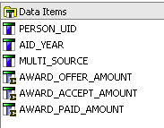
Creating Tabs ….
Step 1– Create Queries
Create your report query/queries however you wish. My report query will be a financial aid report with 3 different award values:

Slide 5
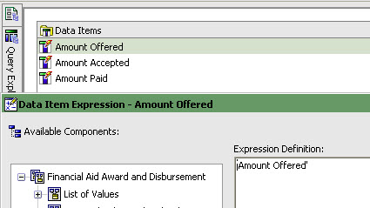
Creating Tabs ….
Step 1 cont. – Create Queries
Create separate query with Tab names only
Drag in data items and set them equal to the value you want displayed
Name each data item the same as its value, for simplicity’s sake

Slide 6
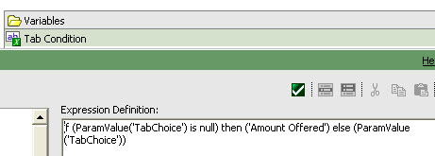
Creating Tabs ….
Step 2 – Create String Variable
In condition Explorer, set the Express Definition such that it will display a default tab when the report is initially run, else to obey a link we will later create:

Slide 7

Creating Tabs ….
Step 2 cont. – Create values for the Tab Condition variable. They must be identical to the values in the Query we created in Step 1:

Slide 8
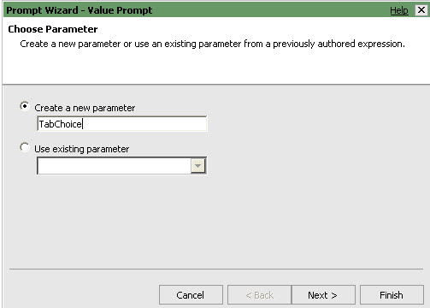
Creating Tabs ….
Step 3 – Create Parameter
On the page view, drag in a value prompt.
From the wizard, name the parameter ‘TabChoice’ and click “Finish”

Slide 9
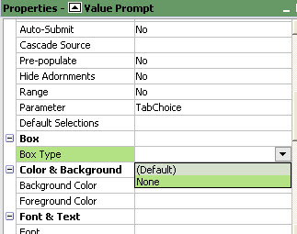
Creating Tabs ….
Step 3 cont. – Create Parameter
Highlight the value prompt, and in the properties, set the Box Type to “None” in order to hide this prompt

Slide 10
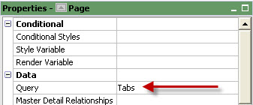
Creating Tabs ….
Step 4 – Associate the Page with the Tab query

Slide 11
Creating Tabs ….
Step 5 – Create tabs
Drag a table onto your page body. Make it as many columns as you will have tabs, with a single row.
Drag Text items into each cell, label them with the tab headings you wish, and format however you wish

Slide 12
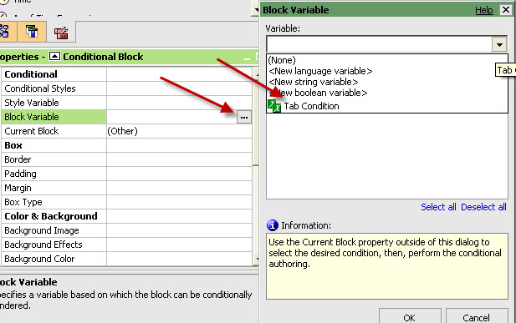
Creating Tabs ….
Step 6 – Create/Define a conditional block
Drag a conditional block into the body of the page, below the tab headers you just created
Highlight the block, and in the properties, set the Block Variable to the variable you created in step 2

Slide 13
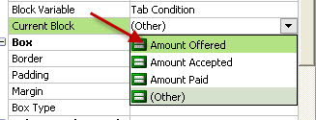
Creating Tabs ….
Step 7 – Define each value of the conditional block
With the conditional block highlighed, in properties, change the current block to your first option:
Drag a list, crosstab, or whatever into the conditional report & create report for that “tab”

Slide 14
Creating Tabs ….
Step 7 cont.
Repeat this for each tab option by changing the conditional variable’s current block to each value, and creating a report for that value.

Slide 15
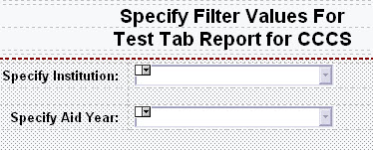
Creating Tabs ….
Step 8 – Set up any prompts you may need
Since CCCS uses a VPD, we always filter on Institution
This report will also filter on aid year

Slide 16
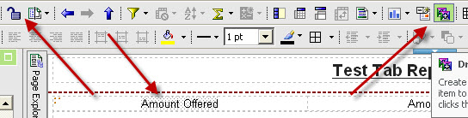
Creating Tabs ….
Step 9 – Set up tab links
We will use drill-through to create links for each tab
Unlock the report
Highlight the text you wish to hyperlink
Click on the “Drill Through” button

Slide 17
Creating Tabs …
Step 9 cont. – Set up tab links
In the drill-through box, create a new drill through, set the report equal to the same report (assuming you have already saved it), and set the parameters equal to your prompt values, and your TabChoice parameter equal to your hard-coded value.
Screen shot on next page….

Slide 18
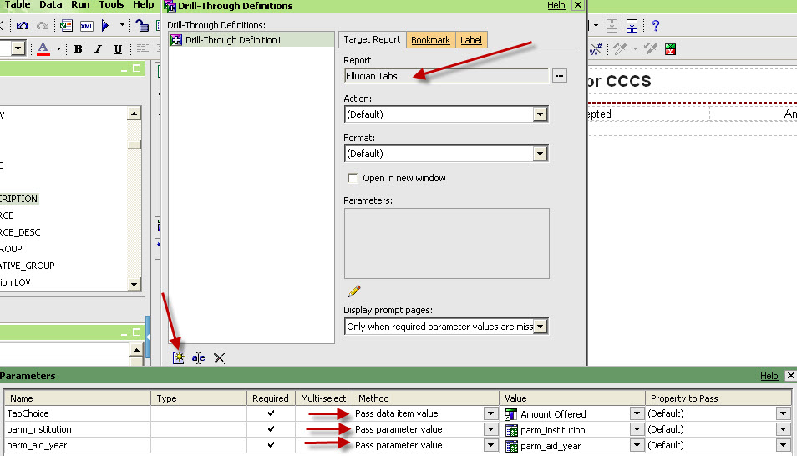
Creating Tabs ….
Step 9 cont.

Slide 19
Creating Tabs ….
Step 9 cont.
Repeat for each tab value, until all tabs have hyperlinks

Slide 20
Creating Tabs ….
Step 10 – Formatting Tabs
It’s a good idea to format your tabs so you know which one is the active tab. Use conditional formatting to accomplish this. Screen shot on next page…

Slide 21
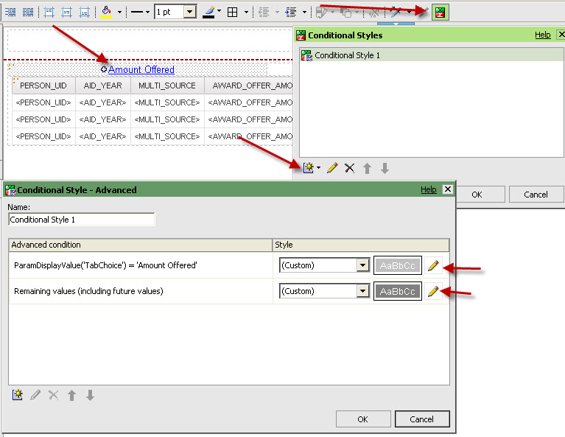
Creating Tabs ….

Slide 22
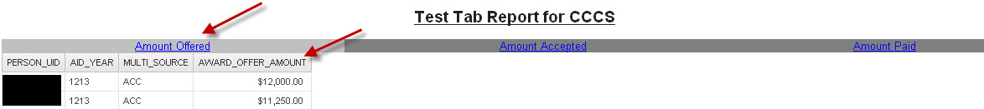
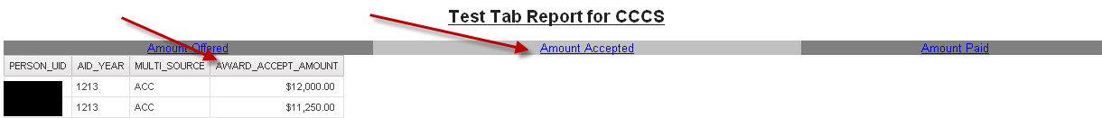
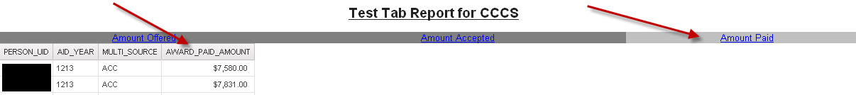
Test Your Report with Tabs!
Amount Offered:
Amount Accepted
Amount Paid

Slide 23
Questions????
Bryan.Mack@cccs.edu

